Slide 1


Data-Driven Storytelling Presentation: ACCOUNT PERFORMANCE METRICS AND SALES TREND
BY
EKOH STELLA

Slide 2
Agenda
INTRODUCTION
PROCESS
THE ANALYTICS TEAM
INSIGHTS
SUMMARY

Slide 3
Introduction
PROBLEM
J.P. Morgan is a global leader in the financial services, that offer services to the world’s most important corporations.
The Data Analytics team is looking to analyze the account performance. metrics and sales trend for the 5years period between 2017-2021.
BUSINESS QUESTIONS
Top and bottom performing accounts.
How sales are growing year over year.
Which account types are selling more units than others.
The year with the highest volume sales.
Volume sales by account name for 2020 and 2021.
TOOLS USED
Excel

Slide 4
THE ANALYTICS TEAM
.
Data Analyst
Ekoh Stella
Data
Analyst
Odozi Whitney

Slide 5
PROCESS
WE APPROACHED THE PROBLEM WITH THE FOLLOWING STEPS:
DATA UNDERSTANDING: The key success to any data project is to understand the data in detail. So we took time to understand the data model and domain of your business.
2. DATA MODELLING: From the existing dataset, we needed to process and model this data into a dataset that can precisely answer the business questions and produce analytics.
3. DATA ANALYSIS: With our new dataset, we used our analytical expertise to uncover insights from this dataset and to produce visualizations to describe the insights.
4. UNCOVER INSIGHTS: Finally, we have used these insights to unlock business decisions and to make recommendations on the next steps.

Slide 6
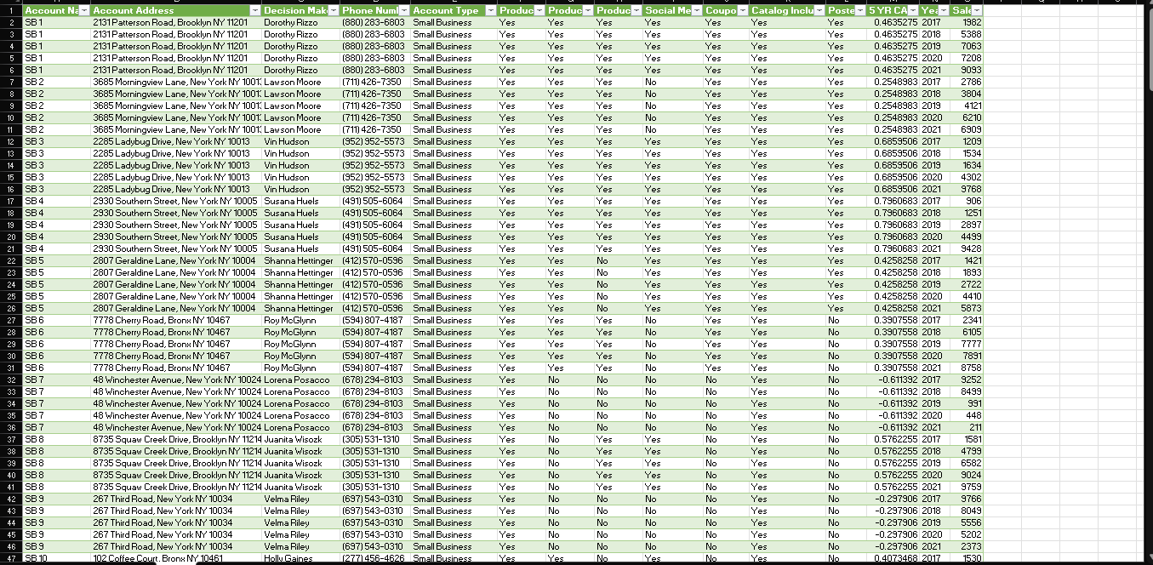
DATA MODELLING
We used power query to transform the dataset in other to make it better organized

Slide 7
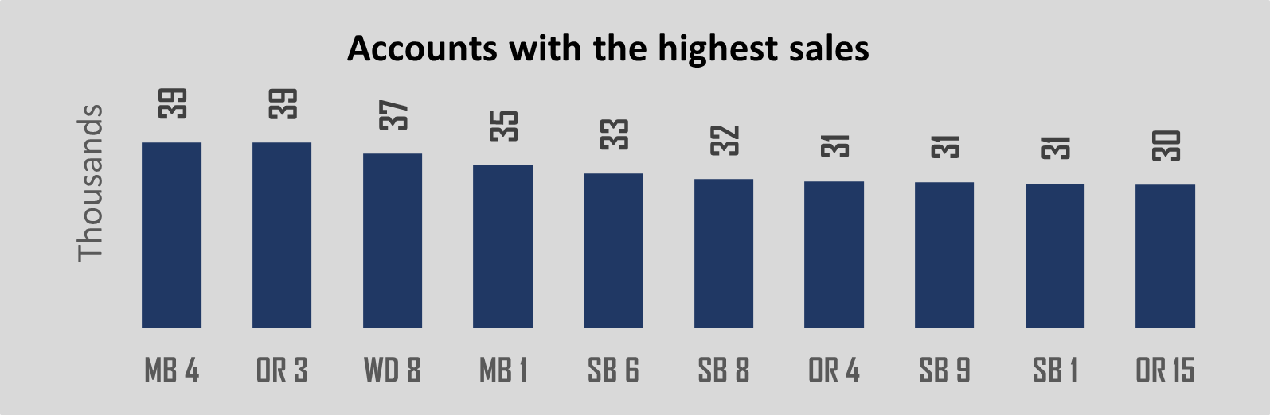
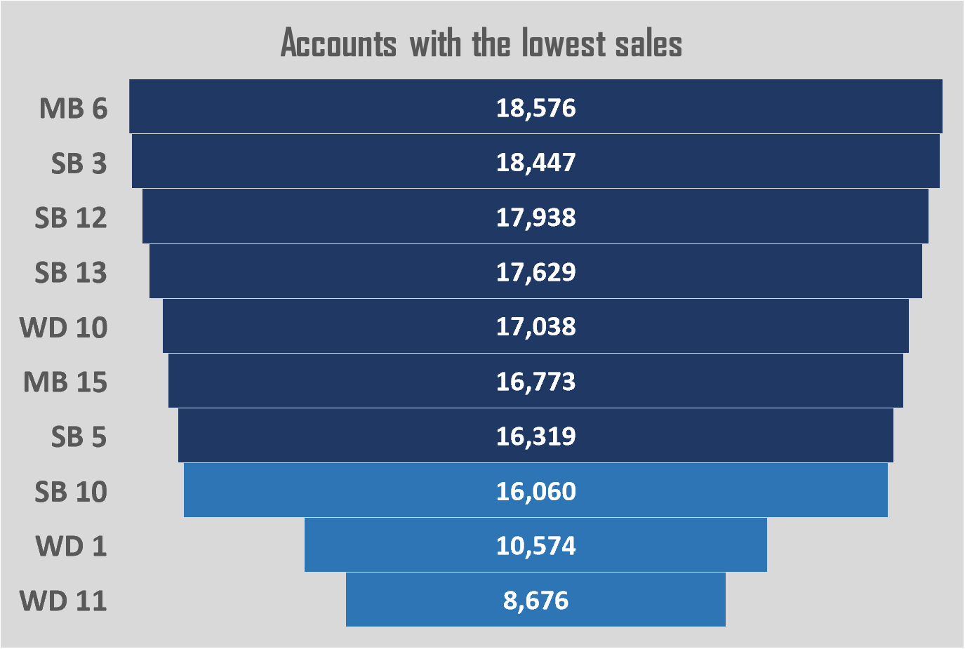
DATA ANALYSIS
The account name MB4 proved to be the most performing account, garnering an impressive volume of approximately 39,413 units in sales. While accounts WD11, WD1, and SB10 respectively are the lowest performing accounts in terms of sales volume, with WD11 having 8,676 units, WD1 10,574 units and SB10 – 16,060 units, all of volume sales.

Slide 8
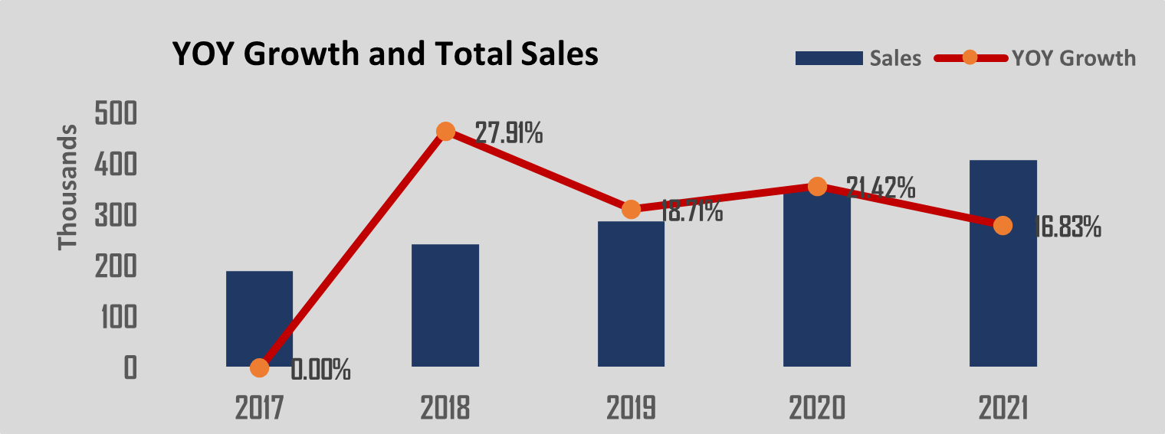
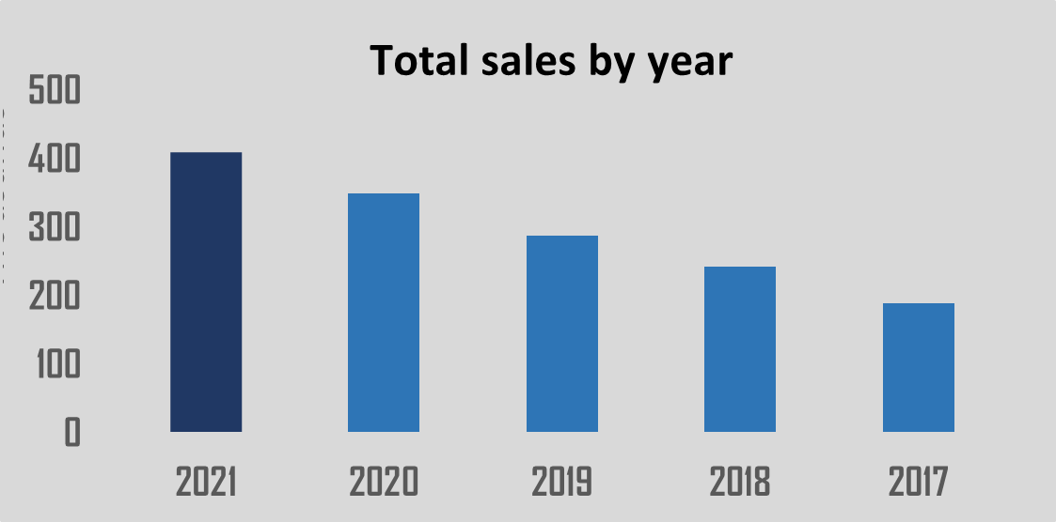
DATA ANALYSIS
2021 recorded the highest sales volume, while 2018 showed a substantial increase in sale volume followed by a drastic drop in 2019. However, 2020 witnessed an increase and 2021 saw slight decline in sales volume.

Slide 9
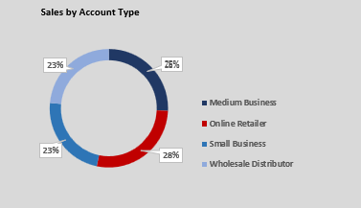
DATA ANALYSIS
Online Retailer generated the highest sales volume, totaling 408,515 units, accounting for 28% of the total sales volume. Medium Business followed closely behind with sales volume of 380,568 units, comprising of 26% of the total sales volume.

Slide 10
SUMMARY
In summary, we tackle the task and found that:
The account name MB4 proved to be the most performing account, garnering an impressive volume of approximately 39,413 units in sales. While accounts WD11, WD1, and SB10 respectively are the lowest performing accounts in terms of sales volume, with WD11 having 8,676 units, WD1 10,574 units and SB10 – 16,060 units, all of volume sales.
2021 recorded the highest sales volume, while 2018 showed a substantial increase in sale volume followed by a drastic drop in 2019. However, 2020 witnessed an increase and 2021 saw slight decline in sales volume.
Online Retailer generated the highest sales volume, totaling 408,515 units, accounting for 28% of the total sales volume. Medium Business followed closely behind with sales volume of 380,568 units, comprising of 26% of the total sales volume.
We recommend closing these underperforming accounts immediately and launching an effort to identify the highest potential online retailer accounts for increased sales and marketing investments.

